Slide 1


Module 3: Kubernetes Overview
Kubernetes –
Overview

Slide 3

Kubernetes Architecture

Slide 4
Cloud-Native Principles
Cloud-native principles are as follows:
Container packaged: Isolated unit of work that does not require OS dependencies
Dynamically managed: Actively scheduled and managed by an orchestration process
Microservice oriented: Loosely coupled from other dependencies

Slide 5
About Kubernetes
Kubernetes is an open-source cluster management tool:
Automates the deployment, management, and scaling of applications
Managed by Cloud Native Computing Foundation (CNCF)
Actively developed by a well-supported community, including former Borg engineers
Lessons learned from Borg in production for more than a decade
Can run on bare metal, hypervisors, or on various cloud providers

Slide 6
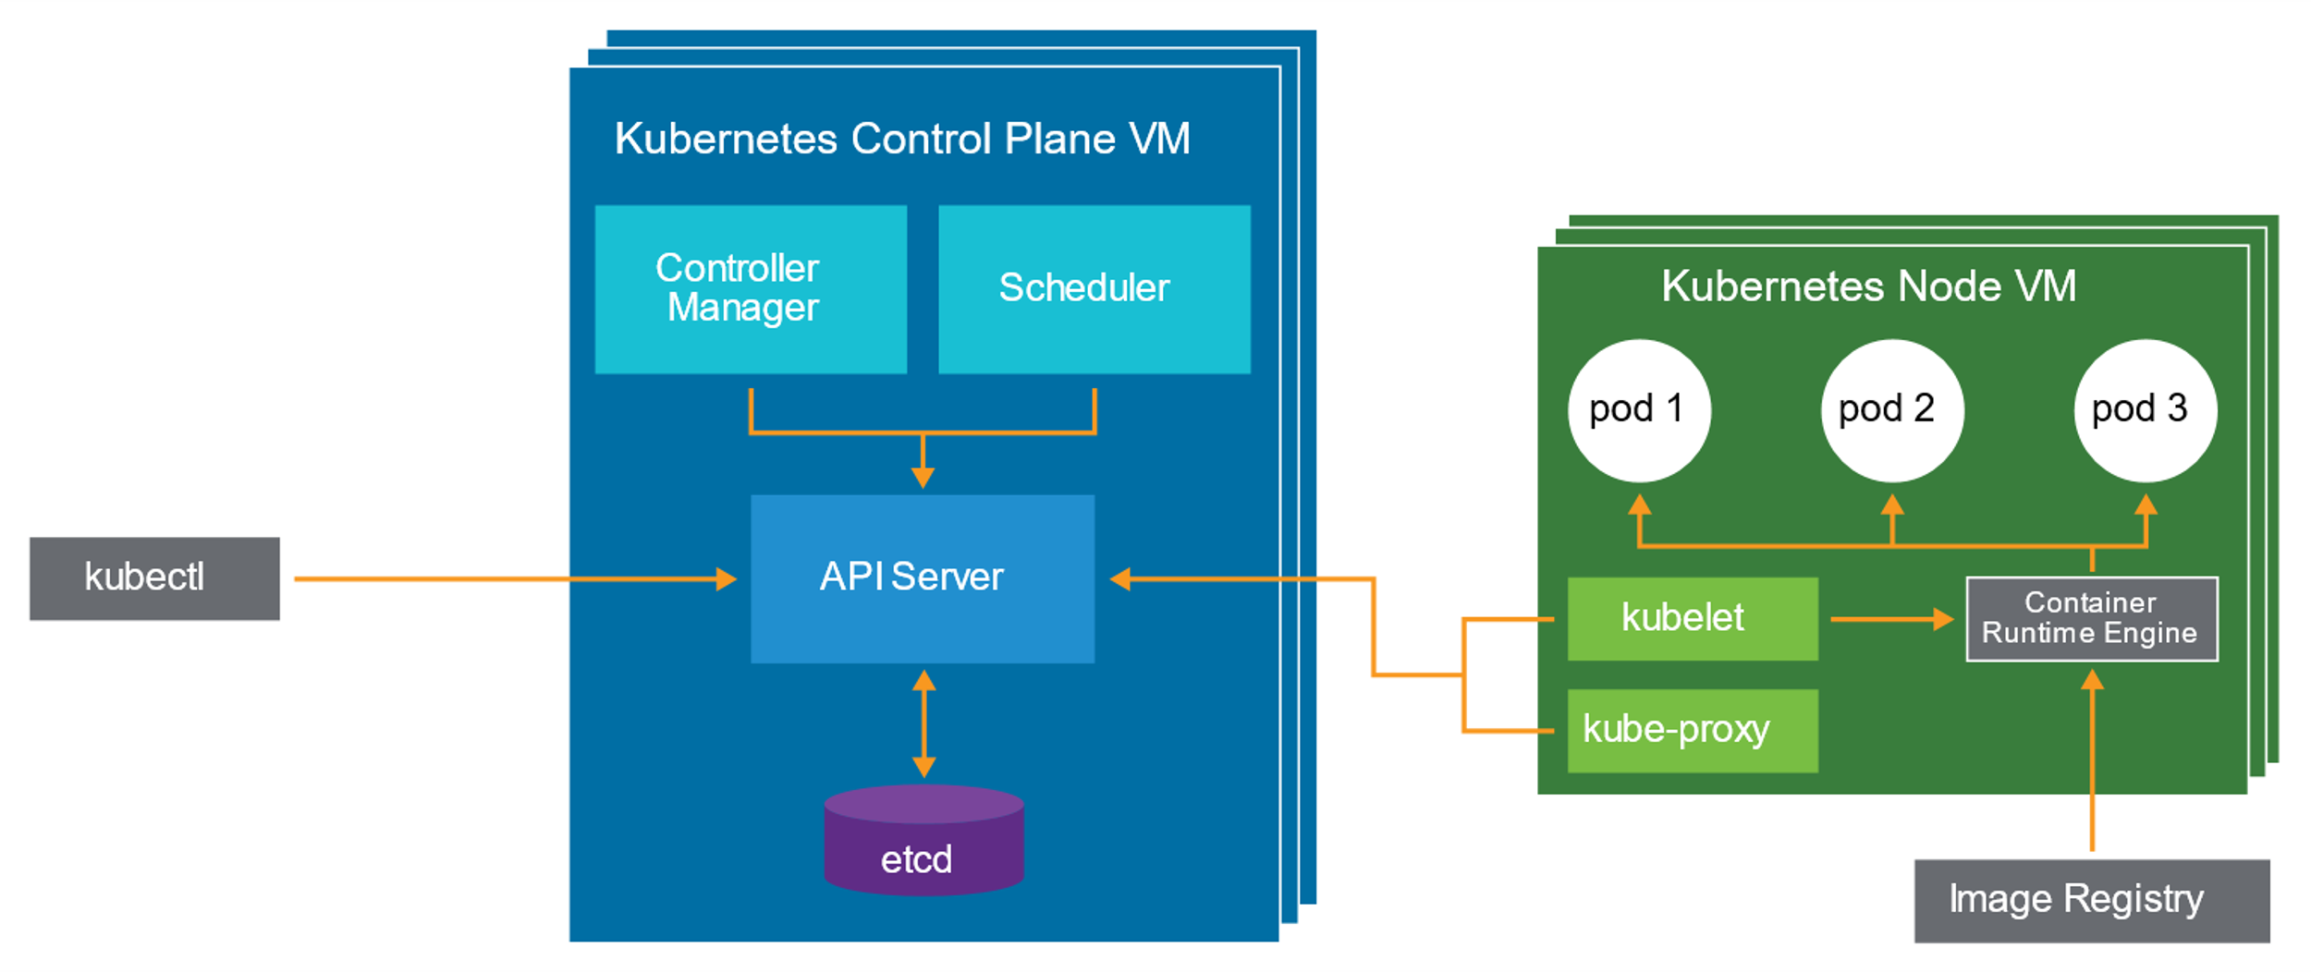
Kubernetes Architecture
The Kubernetes architecture includes several components.
Notes:
The Kubernetes architecture includes the following components:
kubectl: The command-line interface (CLI) to the Kubernetes API
Kubernetes master or control plane VM:
API server: The entry point into the Kubernetes platform
etcd: The key/value datastore used to store the configuration and current state of the system
Controller manager: Runs various controllers that watch the API for changes and take appropriate action
Scheduler: Balances pods across nodes
Kubernetes worker node:
kubelet: Watches the API for work assigned to it
kube-proxy: Configures networking rules to route traffic to containers
Docker: Runs pods when requested by kubelet
Kubernetes automates many key operational responsibilities, providing the developer with a reliable environment.
Each architectural component focuses on one task, increasing resource utilization, reliability, and consistency.

Slide 7
Problems Solved by Kubernetes
With Docker, containers are managed on a single container host. Managing multiple containers across multiple container hosts creates issues in the following areas:
Managing large numbers of containers
Restarting failed containers
Scaling containers to meet capacity
Networking and load balancing
Kubernetes provides an orchestration layer to solve these issues.
Notes:
Previously, operations provided sets of VMs to support applications. Now, operations provides a dynamic set of container hosts that support a large architecture of containerized services.
Providing a set of container hosts adds complexity to operational support, requiring solutions that automate the delivery of operational requirements. Each application is a now set of containers.

Slide 8
About Manifests
In Kubernetes, manifest files declare the desired state of objects.
Manifests have the following properties:
YAML format
Declarative configuration
Desired API primitives
Kubernetes manages the creation of the requested primitives.
Notes:
Manifest files are the new shared language between the developer and the operator. They act as the single source of truth for the configuration of a set of application components (containers). For more information about YAML, see "Yet Another Markup Language" at https://yaml.org/spec/history/2001-05-26.html.

Slide 9
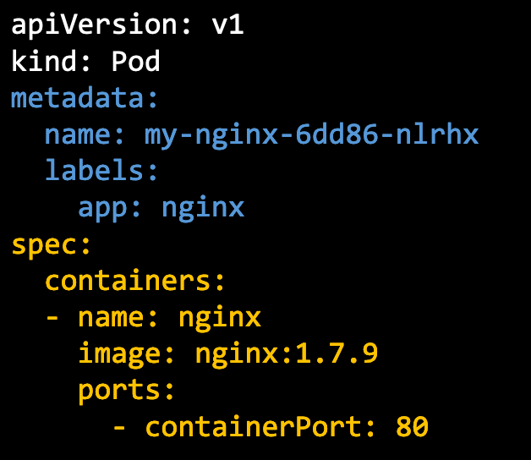
About Pods
A pod is a set of one or more tightly coupled containers.
It is the smallest unit of work in Kubernetes.
Containers in a pod live and die together.
Create a pod example:
The pod has a label app with the value nginx.
The pod runs the image nginx with version 1.7.9.
The pod listens on port 80.
Notes:
For more information about Kubernetes pods, see the Kubernetes website at https://kubernetes.io/docs/concepts/workloads/pods/pod/
The Kubernetes architecture has many objects and other conceptual primitives..

Slide 10
Pod-to-Container Relationship
A Kubernetes pod is created to run a container. Additional containers can be defined.
Pod
Web Server Container
Pod IP: 192.168.2.40

Slide 11


Kubernetes Building Blocks
The building blocks of Kubernetes are pods, nodes, and clusters:
Pod: Containers are encapsulated in pods.
Node: A container host, for example, a virtual machine running Docker engine.
Cluster: A set of worker nodes (data plane) that are managed by a control plane node.
Control Plane
Data Plane
Kubernetes Worker Node (Container Host)
Worker Node
Pod
Pod
API
Container
Container
Kubernetes Control Plane Node
containerd
Stem
…
B
Stem
VM
B
Stem
B
Worker Node
VM
VM
Worker Node
VM
Kubernetes Cluster
VM
Notes:
Conceptually, Kubernetes nodes are very similar to container hosts. In the Kubernetes API, nodes are software objects that represent nodes. Node objects can refer to either physical machines or VMs.
Node machines are not deployed by Kubernetes. Nodes are created by the underlying infrastructure. For example, in VMware Enterprise PKS, nodes are VMs that are created by vCenter. After creation, the Kubernetes controller confirms whether the new node is valid.
A Kubernetes cluster refers to a group of nodes that are firewalled from the Internet. These nodes are the primary compute resources managed by Kubernetes.
The data plane contains the worker nodes. The worker nodes host containerized applications and are managed by at least one Kubernetes controller node.
The control plane contains the Kubernetes primary or controller nodes. More than one Kubernetes control plane node can be used in a Kubernetes cluster to provide high availability for the cluster’s control plane.
In the Kubernetes API, the concept of a hypervisor does not exist. In the Kubernetes API, it does not matter whether a node is a physical machine or a VM that is hosted on a hypervisor. A hypervisor is something that is only significant within the context of the underlying infrastructure.

Slide 12
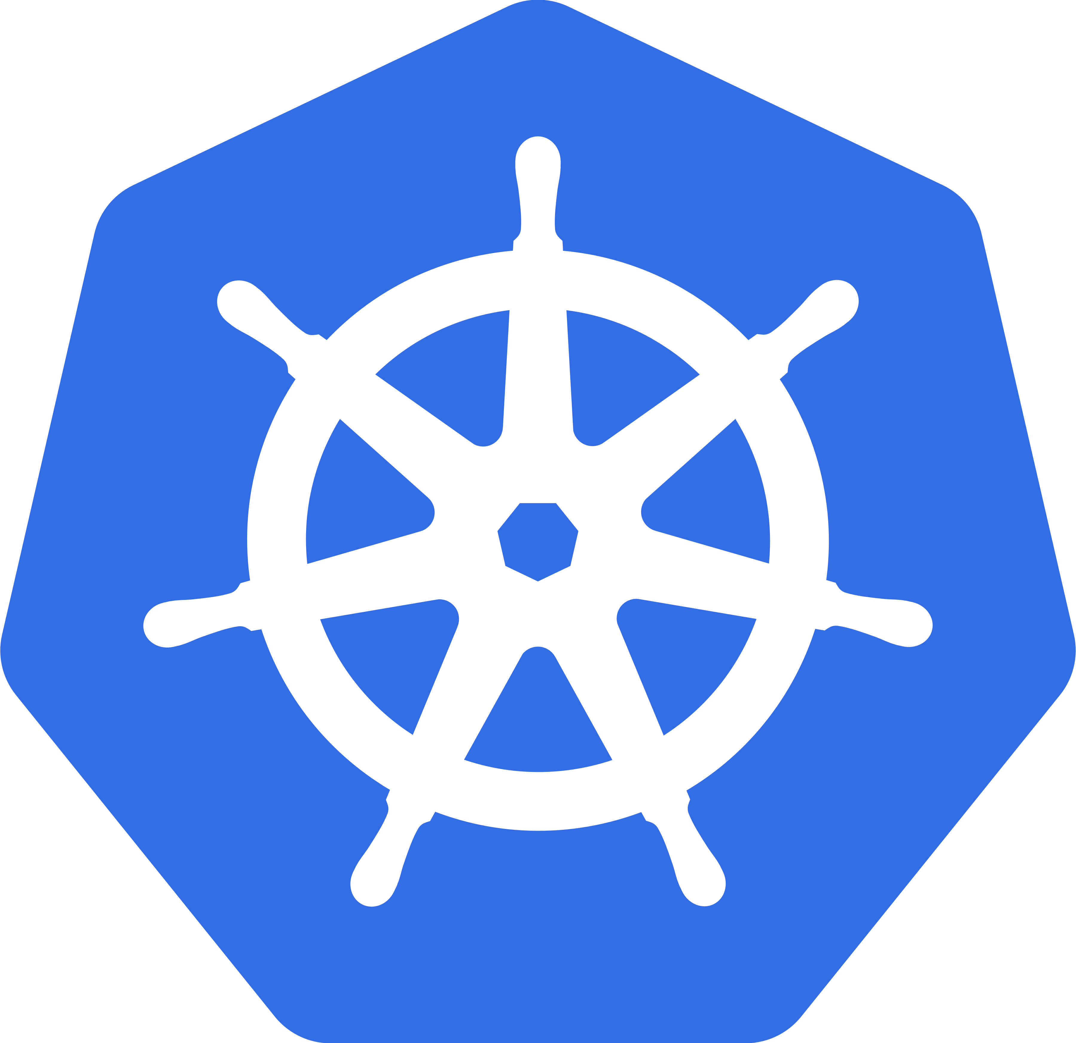

Kubernetes Cluster Architecture
A Kubernetes cluster is a set of worker nodes managed by a control plane node. Typically, a Kubernetes node is a virtual machine.
Kubernetes Cluster
Control Plane Node
kubelet
kubelet
kubelet
kube-apiserver
kube-proxy
kube-proxy
kube-proxy
Container
Container
Container
kube-scheduler
…
kube-controller-manager
Pod
Pod
Pod
Key-Value
Store
Containerd
Containerd
Containerd
Worker Node
Worker Node
Worker Node
Notes:
A Kubernetes node is similar to a container host. It can be a standalone physical machine or a VM.
A cluster in VMware terminology is different from a cluster in Kubernetes terminology.
A VMware ESXi cluster represents a set of ESXi hosts (physical machines) with compute and memory resources that share the same network and storage arrays. Discussions of ESXi clusters usually refer to VMware high availability (HA) clusters and the load balancing of virtual machines.

Slide 13
Kubernetes Control Plane Node
The control plane's components make global decisions about the cluster. They also detect and respond to cluster events.
Kubernetes front-end control plane
Provides RESTful interface
Returns state objects as JSON
Control Plane Node
kube-apiserver
Key-value store
Leader-based clustering
Can be clustered across master nodes
Contains all state known about cluster
Key-Value
Store
ETCD
kube-controller-manager
Provides core control loops for platform
Watches shared state through apiserver
Makes changes from current to desired
kube-scheduler
Policy-based workload scheduler
Topology aware
Assists with availability, performance, and capacity
Affinity and anti-affinity capable

Slide 14
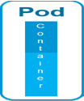
Kubernetes Worker Node
A Kubernetes worker node is typically a virtual machine.
The Kubernetes node agent kubelet ensures that containers described in pod specifications are running and healthy.
Kubernetes Worker Node
kubelet
kube-proxy performs these functions:
Load balances interface for pods
Creates a virtual IP address for external access
Dynamically updates the node’s local iptables to map references to a service port to a pod endpoint
kube-proxy
…
A pod is the smallest deployable unit of computing that can be created and managed in Kubernetes.
Reimplementation of Docker’s containerd
Container Runtime Interface (CRI) plug-in replaces dockershim
Containerd
CRI Plug-In
Notes:
For more information about Kubernetes components, see the following resources:
Kubernetes documentation at https://docs.kubernetes.io
Kubernetes API reference at https://docs.kubernetes.io/docs/reference/
kubectl documentation at https://kubectl.docs.kubernetes.io

Slide 15
Kubernetes Plug-In Architecture
During design, you can select different plug-ins:
Container Runtime Interface (CRI): Interface between Kubernetes and the container runtime engine (docker, containerd)
Container Networking Interface (CNI): Interface between Kubernetes and the networking implementation (NSX-T Data Center, Project Calico, Antrea)
Container Storage Interface (CSI): Interface between Kubernetes and the storage implementation (cloud storage, vendor-specific storage, vSphere Storage Policy Based Management [SPBM]).
Notes:
For a complete list of available choices, see http://l.cncf.io.

Slide 16
Kubernetes Tools
Several tools are available to build a Kubernetes cluster. Each has different goals (development or enterprise):
kubectl
minikube
kind
kubeadm
Cluster API
Notes:
For more information about Kubernetes tools, see http://kubernetes.io.

Slide 17
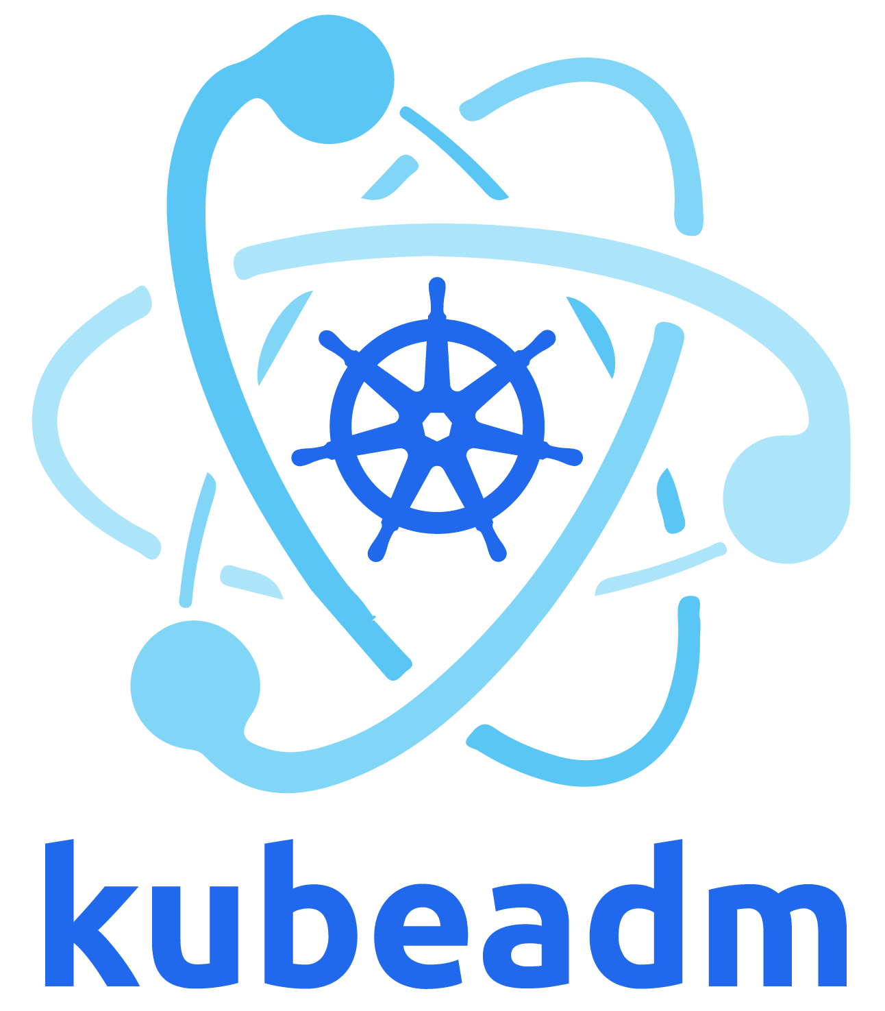
About kubeadm
Bootstrap minimum viable cluster:
Control plane creation and setup
Joining nodes
Certificate creation and management
Initial cluster-admin account setup

Slide 18
Lesson 2: Kubernetes kubectl CLI

Slide 19
API: REST
REST JSON-based API works in the following ways:
All internal and external components communicate through this API.
It is explicitly versioned so that future changes can be made.
It provides an abstraction layer on top of the storage (etcd).
curl http://localhost:8001/api/v1/pods
{
"kind": "PodList",
"apiVersion": "v1", "metadata": {
"selfLink": "/api/v1/pods", "resourceVersion": "3606680"
},
"items": [

Slide 20

API: kubectl
The command-line interface for the API is called kubectl:
Calls one or more REST API calls for each command-line invocation
Contains some business logic not in the API
$ kubectl get pods
NAME | READY | STATUS | RESTARTS | AGE
blog-56d5c9dbf7-6j67j | 1/1 | Running | 0 | 19s
blog-56d5c9dbf7-dh7vb | 1/1 | Running | 0 | 19s
blog-56d5c9dbf7-zv7d7 | 1/1 | Running | 0 | 19s

Slide 21

About kubectl Command-Line Interface
You can use the command-line tool kubectl to control Kubernetes clusters:
This tool is used to authenticate to a Kubernetes cluster.
The kubectl client version must be compatible with the Kubernetes API service version.
The kubectl CLI is available for Linux, macOS, and Windows operating systems.
Notes:
For more information about the kubectl CLI, see https://kubernetes.io.

Slide 22
Interacting with Kubernetes Objects Using kubectl (1)
Common kubectl commands include the apply, get, describe, and delete commands:
The kubectl apply command applies the contents of a YAML file.
Typically, this command is used to create a pod or deployment:
kubectl apply -f /path/to/my.yaml
The kubectl get command returns basic information about an object:
kubectl get pod <pod_name_name>
Notes:
Tab autocompletion can be enabled for kubectl commands. For more information, see Optional kubectl configurations at https://kubernetes.io.

Slide 23
Interacting with Kubernetes Objects Using kubectl (2)
The kubectl describe command returns verbose information about an object:
kubectl describe pod <pod_name>
The kubectl delete command deletes an object:
kubectl delete pod <pod_name>

Slide 24
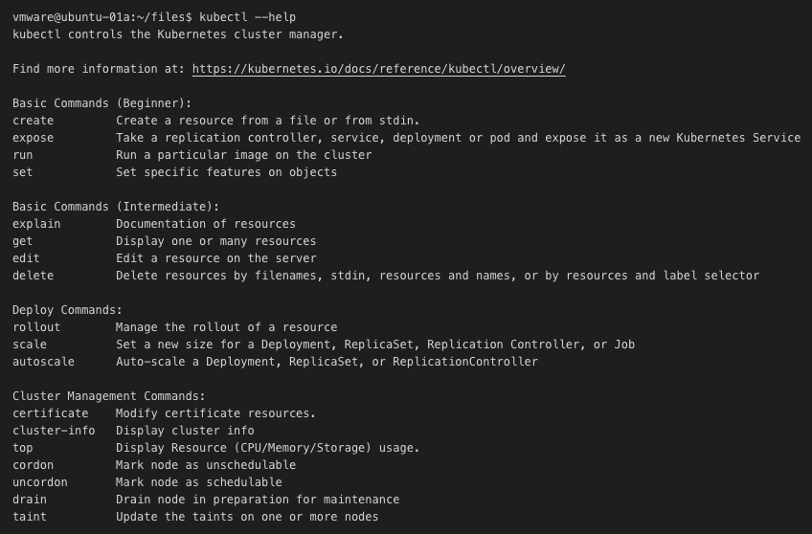
Kubectl Commands (1)
Notes:
kubectl controls the Kubernetes cluster manager. You can select which cluster you want to interact with and make changes using kubectl commands.

Slide 25
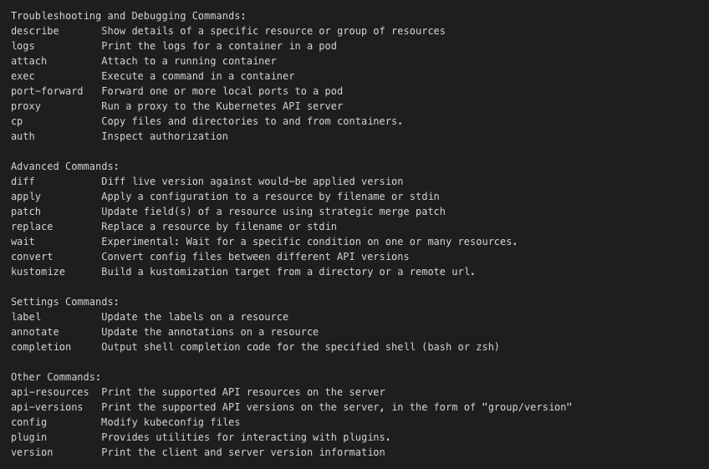
Kubectl Commands (2)

Slide 26
Commands: kubectl get nodes
To list all the nodes in the selected Kubernetes cluster, you run the following command:
kubectl get nodes

Slide 27
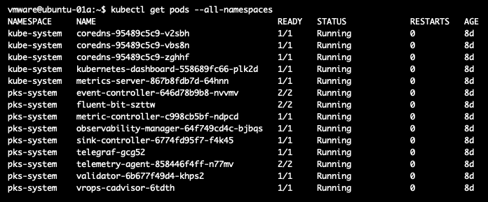
Commands: kubectl get pods
To list all pods in the selected namespace, you run the following command:
kubectl get pods
Notes:
Running the kubectl get pods command lists all pods in the selected namespace. The All-namespaces flag lists all the pods, including the system pods.

Slide 28
Navigating Namespaces Using kubectl
A user can have permissions on multiple namespaces. The kubectl commands are typically actioned against the current active namespace.
View the list of available namespaces:
kubectl config get-contexts
Change the current active namespace:
kubectl config use-context <namespace>

Slide 29
Kubernetes Troubleshooting: Event Log
The event log records events on the cluster:
Contains helpful troubleshooting information
By default, stores an hour of history
$ kubectl get events
LAST SEEN | TYPE | REASON | KIND | MESSAGE
2m14s | Normal | NodeHasSufficientMemory | Node | Node master | status | is | now: | NodeHasSufficientMemory
2m14s | Normal | NodeHasNoDiskPressure | Node | Node master | status | is | now: | NodeHasNoDiskPressure
2m14s | Normal | NodeHasSufficientPID | Node | Node master | status | is | now: | NodeHasSufficientPID
2m14s | Normal | NodeAllocatableEnforced | Node | Updated Node Allocatable limit across pods
51s | Normal | RegisteredNode | Node | Node master event: Registered Node master in Controller
38s | Normal | Starting | Node | Starting kube-proxy.

Slide 30
Getting a List of Objects
You run kubectl get to retrieve a list of objects.
You add -o wide for more details about each object.
$ kubectl get pods –o wide
NAME | READY | STATUS | RESTARTS | AGE | IP | NODE
gowebapp-54d74586cc-jqlmx | 1/1 | Running | 0 | 3m5s | 192.168.0.7 | master
gowebapp-54d74586cc-sqpfk | 1/1 | Running | 0 | 3m5s | 192.168.0.6 | master
gowebapp-mysql-9746475d-gdhtx | 1/1 | Running | 0 | 3m35s | 192.168.0.5 | master
# When using –o wide with `kubectl get pods` the output will include the Pod’s IP address, and which # node it’s running on.

Slide 31
Getting More Information About an Object
You run kubectl describe to view details about an object.
The output includes event log entries that are generated by that object.
$ kubectl describe pod gowebapp-54d74586cc-jqlmx
Name: Namespace: Node:
Start Time: Labels:
Status:
IP:
Controlled By:
gowebapp-54d74586cc-jqlmx default master/172.31.30.8
Wed, 08 May 2021 15:17:46 +0000
app=gowebapp tier=frontend Running 192.168.0.7
ReplicaSet/gowebapp-54d74586cc

Slide 32
Example: kubectl describe
Containers: gowebapp:
Container ID: Image:
Image ID:
Events:
Type Reason
docker://ae0321def949ed866fb0c303207eaa0d3188dd9830f648d52196418637bda13d localhost:5000/gowebapp:v1
docker-pullable://localhost:5000/gowebapp@sha256:8227…
Age From
Message
Normal
Scheduled
11m default-scheduler
Successfully assigned default/gowebapp-54d7458… to master
Normal | Pulled | 11m | kubelet, | master | Container image "localhost:5000/gowebapp:v1" already present…
Normal | Created | 11m | kubelet, | master | Created container
Normal | Started | 11m | kubelet, | master | Started container

Slide 33
Creating Resources
Declarative approach (preferred):
Creates new or updates existing resources from files
kubectl apply -f [ <file> | <directory> | <url> ]
Imperative approach:
kubectl create: Creates new resource from a file
kubectl replace: Updates an existing resource from a file
kubectl edit: Updates existing resource using your default editor
kubectl patch: Updates existing resource by merging a code snippet

Slide 34
Getting Pod Logs
You run kubectl logs to retrieve log output from a container.
You can use –c <container_name> if the pod contains more than one container.
$ kubectl logs gowebapp-54d74586cc-jqlmx
2021-05-08 | 03:17:48 | PM | Running HTTP :80
2021-05-08 | 03:41:09 | PM | 172.31.30.8:56701 | GET | /
2021-05-08 | 03:41:09 | PM | 172.31.30.8:56701 | GET | /static/css/bootstrap.min.css?1544384023
2021-05-08 | 03:41:09 | PM | 172.31.30.8:56703 | GET | /static/css/global.css?1544384023
2021-05-08 | 03:41:09 | PM | 172.31.30.8:56705 | GET | /static/js/underscore-min.js?1544384023
2021-05-08 | 03:41:09 | PM | 172.31.30.8:56707 | GET | /static/js/global.js?1544384023
2021-05-08 | 03:41:09 | PM | 172.31.30.8:56701 | GET | /static/favicons/favicon-196x196.png
2021-05-08 | 03:41:11 | PM | 172.31.30.8:56701 | GET | /login
2021-05-08 | 03:41:17 | PM | 172.31.30.8:56701 | GET | /register

Slide 35
Kubernetes Pod Phases
Pending:
The pod was accepted by the system, but one or more of the container images are not created. Includes the time before being scheduled and the time spent downloading images over the network.
Running:
The pod is bound to a node, and all containers are created.
At least one container is still running or is in the process of starting or restarting.
Succeeded:
All containers in the pod have terminated in success and are not restarted.
Failed:
All containers in the pod have terminated. At least one container has terminated in failure (exited with nonzero exit status or was terminated by the system).
Unknown:
The state of the pod cannot be obtained, typically because of an error in communicating with the host of the pod.

